Slide 1
Resources Working Group Update

Slide 2
Distributed Resources
How do we make a worldwide collection of resources usable for sharing of data/computation?
Drive infrastructure by needs of specific use cases
Biodiversity expedition
Lake Ecology Expedition
Experimental Networking Testbed
++ Needs of other PRAGMA Working group
We’re trying something new this meeting

Slide 3
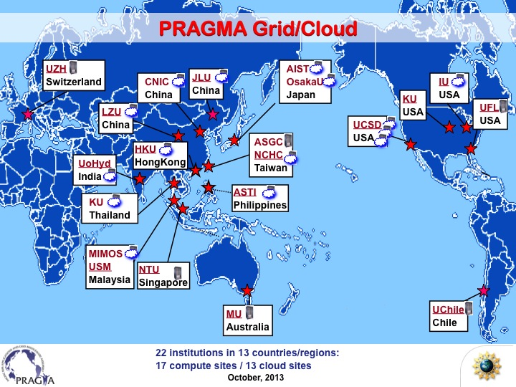
In progress goal: Rebuilding the PRAGMA Worldwide Testing Infrastructure
Next
Generation
Trying to rebuild infrastructure AND make scientific progress

Slide 4
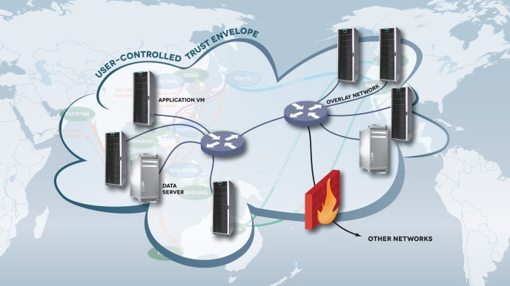
We need controlled sharing for resources
General Idea: identify specific resources needed by distributed researchers.
Then build a “limited access” network to knit together the resources

Slide 5

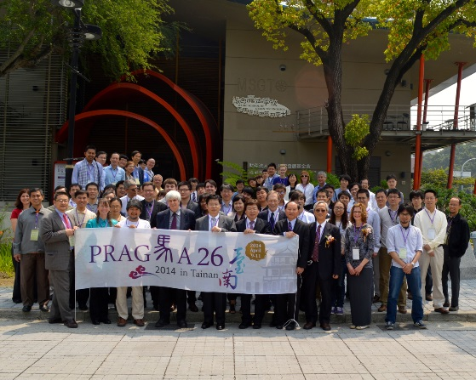
Where Resources fits in for PRAGMA Activities
Enabled International Collaboration
Applications
Technologies
LifeMapper Biodiveristy
Data Provenance
Lake Ecology
Overlay Networks
Network Experiment
Virtual Cluster Migration
Cyber Learning
Application Integration
telescience/Bioscience
Students
Researchers

Slide 6
Improving Interaction of Resources WG with others
Resources WG met yesterday for about 2 hours for a pre-meeting
Today (Thursday):
NO Resources Working Group
Instead: resources WG will participate in the cyberlearning, telescience, bioscience working groups
Goal: find out specifically what is needed
Goal2: Refine the focus for resources
We want to expand the scientific activities that resources supports

Slide 7
Some Specific Updates
Refined integration of Lifemapper – initial ability to access non-public, remote data with a VINE network overlay
First steps towards a resource scheduling (Demo) that will simplify request to access resources at multiple sites.
Improvements and additional applications running on the PRAGMA experimental testbed
Improvement to IPOP (a different overlay network technology)

Slide 8

Distributing Lifemapper across the PRAGMA Infrastructure: the goals
Increase scalability, availability and flexibility of Lifemapper software.
Run Lifemapper on PRAGMA testbed with enabled access to private satellite data.
Increase usability of PRAGMA infrastructure as a framework for deployment of scientific applications and data resources.

Slide 9
Lifemapper on PRAGMA Testbed

Slide 10
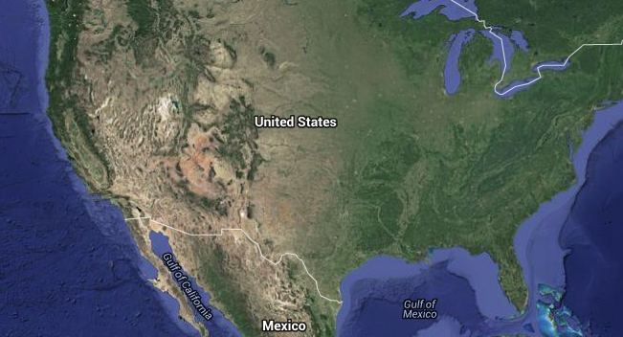
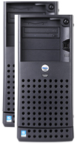
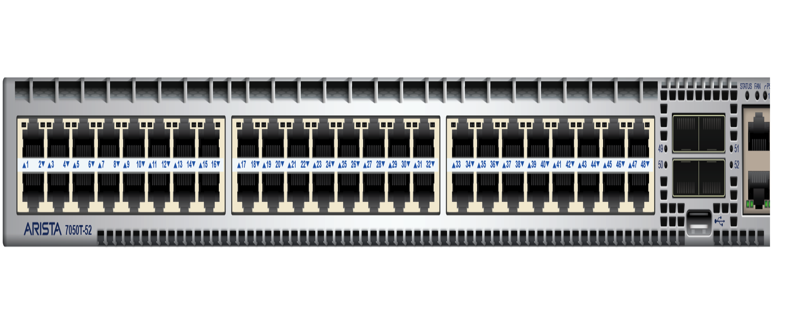

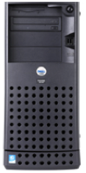
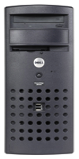
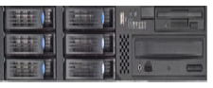
Lifemapper on PRAGMA Testbed
LC
LS
LC
Cloud scheduler
San Diego, CA
DATA
Gainesville, FL

Slide 11
PRAGMA 28 PRAGMA Experimental Network Testbed (ENT)
Maurício Tsugawa (UF)
Kohei Ichikawa (NAIST)

Slide 12
ENT Goals
Build a breakable international SDN testbed for use by PRAGMA researchers
By no means a production system
Complete freedom to access and configure network resources
Provide access to SDN hardware/software to PRAGMA researchers
Offer networking support for PRAGMA multi-cloud and user-defined trust envelopes

Slide 13











ENT Activities
ENT Backbone
TWAREN connected through Pacific Wave
OpenFlow Network Slicing
AutoVFlow deployed and tested (demo)
866
867
858
1404
866
1405
867
1086
1087
2039
3714
1404
3799
1405

Slide 14
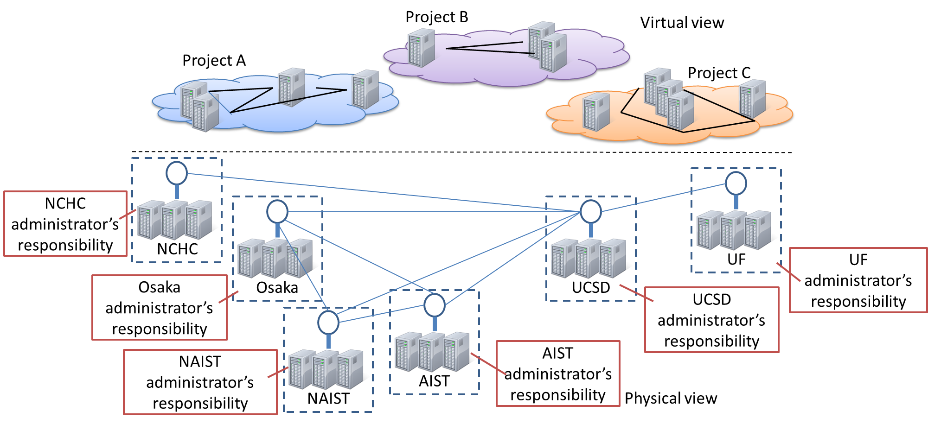
ENT Activities – Control Plane
Distributed implementation via AutoVFlow
Support for multiple experiments

Slide 15
ENT Accomplishments
ENT backbone live
Connection with TWREN established
Static L2 links: NAIST, Osaka U, AIST, UF, UCSD, NARLabs
OpenFlow slicing tested
AutoVFlow deployed at NAIST, UF, UCSD
ENT presented at Internet2 Focused Technical Workshop: International SDN/Openflow testbeds

Slide 16
Future Plans
Network expansion (more sites)
DOCK simulations
Use SDN monitoring capabilities to profile communication pattern while running DOCK
LifeMapper
Address data licensing and security with SDN
End user support
ENT operations center

Slide 17
Using a “Room” scheduler to acquire resources from PRAGMA institutions

Slide 18
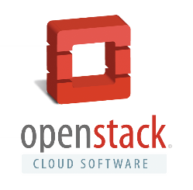



PRAGMA scheduler
SDSC
SDSC
UF
VC
VC
VC
VC
VC
site
Central site
site
Planned VM/VC provisioners
PRAGMA package
ssh
pragma_boot
pragma_agent
PRAGMA
booking
PCC
(per user)
Notes:
Nadya, Shava, Mauricio, and Jose have been working on an initial design and prototype of a pragma scheduler.
Designed to be lightweight and leverages existing technologies such as pragma_boot and PCC.
Scheduler is based on a open source room reservation software tool called Booked.
During demo will show prototype, Booked integrated with pragma_boot (on Rocks). Support for other provisioners other sites might want to use is planned.

Slide 19


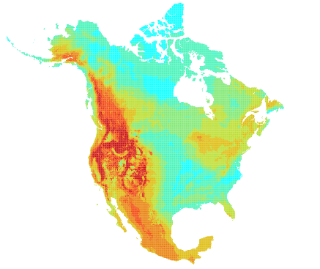
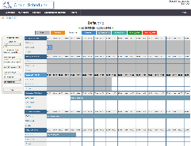
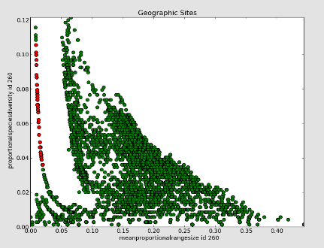
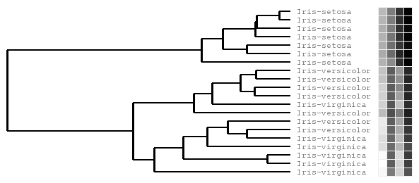
Integral components
VM Software
Rocks 6.2
lifemapper-compute
lifemapper-server
ipop
dynip
vine (package)
SDSC
SDSC
UF
LC
DATA
LS
LC
Lifemapper
site
Central site
site
ecological niche modeling
multi-species range and diversity analysis
visualization
iD
Visualize linked maps, trees and plots
PRAGMA package
ssh
pragma_boot
pragma_agent
species data
PRAGMA
booking
Lm
Lm
Select clade
trees
PCC
(per user)
analyze multi-species data:
measure macro-ecological shifts over time
quantify and qualify biodiversity
OT
http://calit2-119-121.ucsd.edu/cloud-scheduler

Slide 20
Updates and advances in IPOP overlay network technology

Slide 21
IPOP Progress and activities
Software codebase – 15.01
L2 switch mode
Ganglia monitoring
Multi-user chat based GroupVPN
Ongoing development
OpenFlow vswitch bypass
Lake expedition and resources
Windows bug fixes, watchdog service
Upgrade of VM pool at UF; Azure award ($20k)
Rocks integration
Community engagement
Google Summer of Code (expect 2-3 students)
Web-based configuration/management UI
Authentication enhancements

Slide 22
Switch mode
In this mode, IPOP GroupVPN nodes behave as virtual Ethernet switch
IPOP captures outgoing L2 frame
Is it broadcast?
TinCan forwards to all links
Is it unicast?
TinCan looks up (MAC, link) table and forward along matched link, if found
IPOP captures incoming L2 frame
Adds to table: src MAC address, TinCan link

Slide 23
Example: ARP, Containers
ARP who has
10.100.0.3?
Example
VM1 wants to send packet to 10.100.0.3
ARP request message sent from VM1
IPOP tap captures L2 broadcast frame

Slide 24
Overlay Bypass
On-going prototype development
Motivated by containers-within-VM use case
Replace bridge by openvswitch
IPOP controllers detect endpoints are local and configure forwarding/mapping via OpenFlow
Peer discovery,
notification
VPN controller
OSN
Server
Controller
XMPP
TinCan API
JSON/UDP
Container
STUN
Reflection
Server
Socket
API
Packet
Handling
Thread
Link
Setup
Thread
NAT traversal
IPOP-TInCan
Relay
Server
vswitch
TURN
VNIC
Tap ioctl()
API
Send
Recv
VNIC
PNIC (eth)
IPOP-Tap

